Slide 1
child
September 11 2018

Slide 2
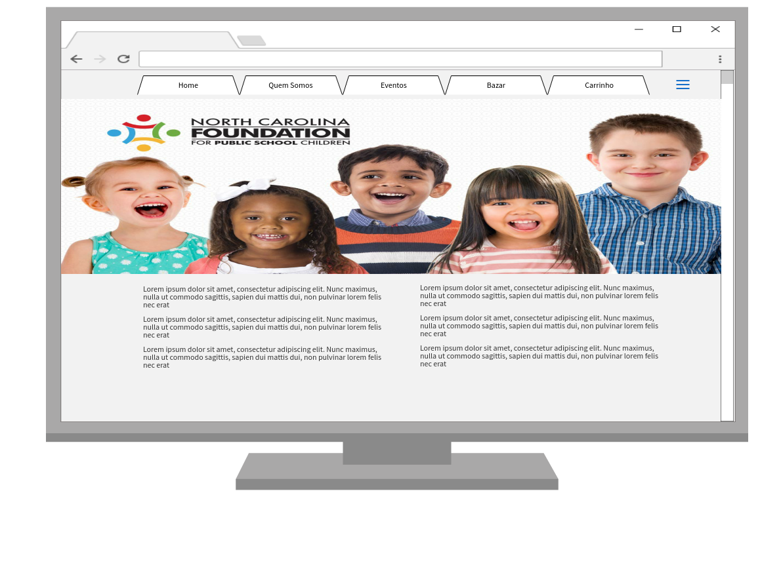

Slide 3
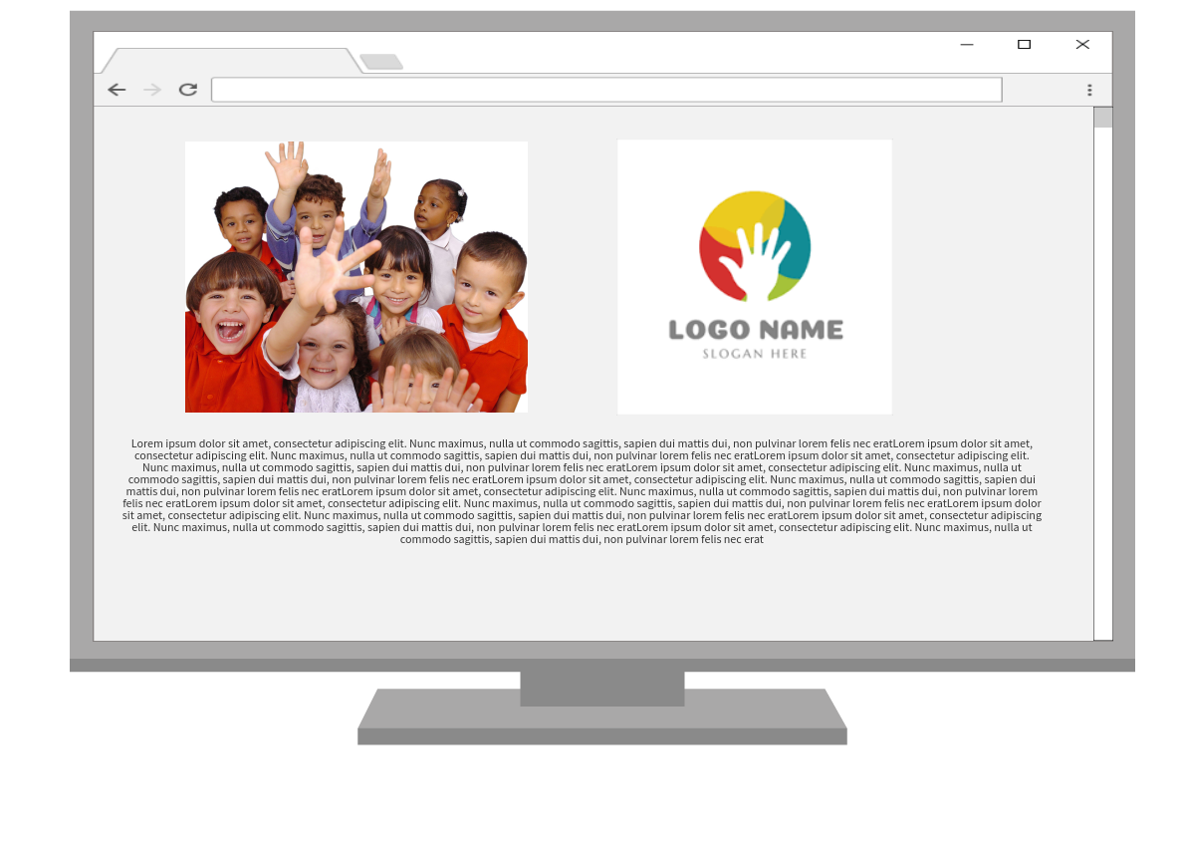

Slide 4
